Slide 1
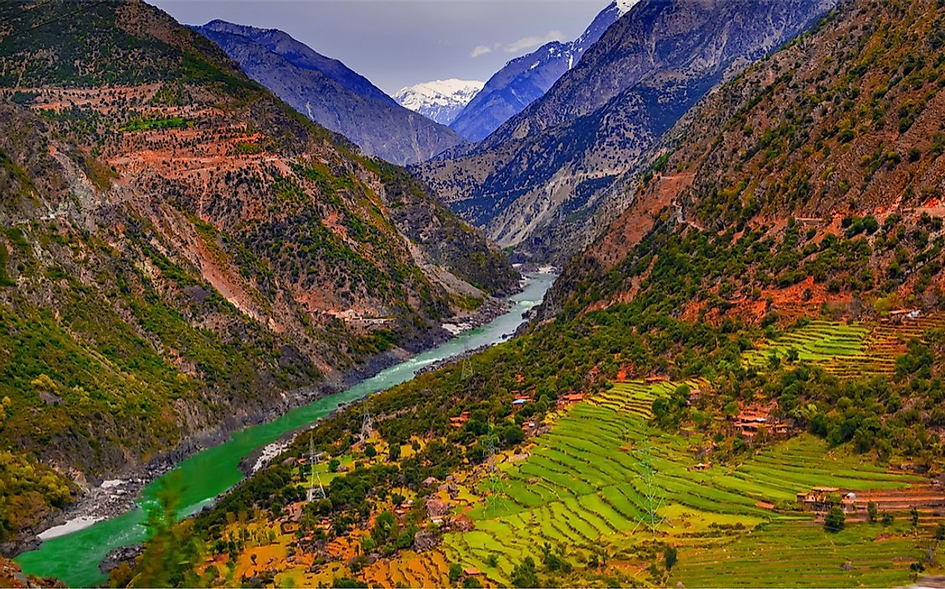
English
This term in English the children will be learning about fable narratives. They will focus on The Fox by Margret Wild. Children will continue to use see a wider range of conjunctions, and Develop understanding of expressing time, place and cause using prepositions.
PE
In P.E the children will be learning how to play Tag Rugby and Dodgeball. The children will be building on the skills they have learnt in a fun and competitive environment.
Maths
Our Math topics this term are multiplication and division followed by length and perimeter. The children will consolidate their fluency skills before applying their understanding in a wider range of contexts. Such as word problems and problem-solving. By the end of the term, the children will be confident in using and applying all four operations in a variety of contexts.
Religious Education
In RE this term the children will be learning about The Incarnation. Children will begin to understand the different features of the Father, Son and holy Ghost, as well as the symbols used by Christians for God and how God and the Holy Spirit are at work in everyday life.
History
In History, we will be learning about the Indus Valley. We will be learning where it is, how this area developed. We will be learning about the area's historical culture, monuments and statues and about the lives of the people who lived their.
Latin
In term 3 the children will be learning about the different verbs forms as the family prepare for a party and a shopping trip!
Geography
In Geography we will be learning about settlements. We will be learning what a settlement is and how they develop. We will be learning about different types of settlement and carrying out case studies on settlements.
The Indus Valley
RHE
In RHE our topic is 'Dream and Goals'. In this unit the children will get a chance to look at how others have overcome obstacles to reach their goals. They will have a chance to find out what motivates them to achieve.
Science
In science we will be learning about magnets and forces. Children will learn about the forces created between two objects and will finish the term researching William Gilbert.
Art and Design
Transforming 2D card shapes into 3D forms, this unit helps children explore abstract shapes, space, and the differences between 2D and 3D art. By manipulating various materials and experimenting with joining techniques, they learn to create free-standing structures inspired by Anthony Caro.
Computing
In Computing we will be focussing on Touch Typing and Branching Databases.
Music
We will continue to learn the ukulele.

