Slide 1
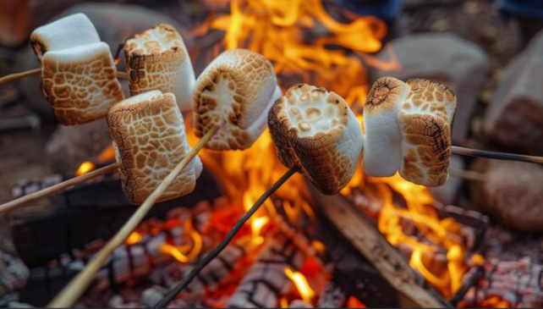
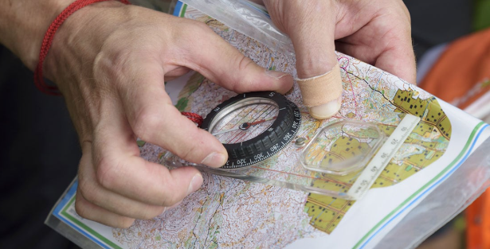
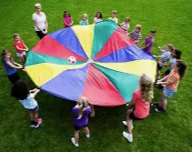
English Homework 11/9/26
Write a recount about your trip to Carroty Wood! Think about:
What happened during the day?
How did the day make you feel?
What did you enjoy the most about your day?
Remember to:
Write in chronological order.
Use first person pronouns.

