Slide 1
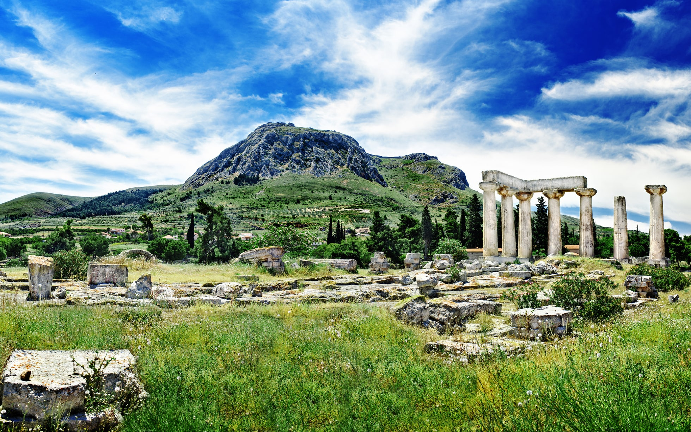
English
This term, the children will be learning about exploration narratives. They will focus on The Search for our Cosmic Neighbours by Chloe Savage. The children will continue to express time, place and cause using adverbs such as next, soon and therefore, as well as prepositions such as after, during and due to.
PE
Our topics for PE are golf and handball.
Maths
In Maths, we will be focusing on measurement, specifically time and money. The children will need to use the four operations to work with money and will understand how to tell the time on a digital and an analogue clock.
(Why not practice telling the time with your children at home to support their learning journey!)
Religious Education
Our topic is Kingdom of God. The focus for this term will be on the story of Pentecost and what Christians mean when they talk about the Kingdom of God.
History
In History, the children will move to the next period of time in Ancient Greece, to learn about wars, literature and democracy in Ancient Greece.
Ancient Greece
Latin
We will be consolidating our understanding of Latin verbs, adverbs and adjectives.
Science
This term in Science, the children will be thinking about plants. The focus will be on the function of different types of plants, as well as investigating how water is transported through plants.
Geography
Our topic is volcanoes. The children will learn what happens when a volcano erupts, learn how volcanoes are formed and understand the difference between dormant, active and extinct volcanoes.
RHE
Our focus will be on caring friendships and different families. The children will be able to identify what a caring friend looks like and different families that make up our school community
Music
The children will continue to learn the ukulele with Rocky.
Computing
We will be thinking about databases, specifically branching data bases. We will use purple mash to help us with our learning.
Art and Design
Our focus will be on Ancient Egyptian Scrolls. We will be exploring ancient scrolls, how to make paper and the children will investigate why ancient scrolls were used.

