Slide 1
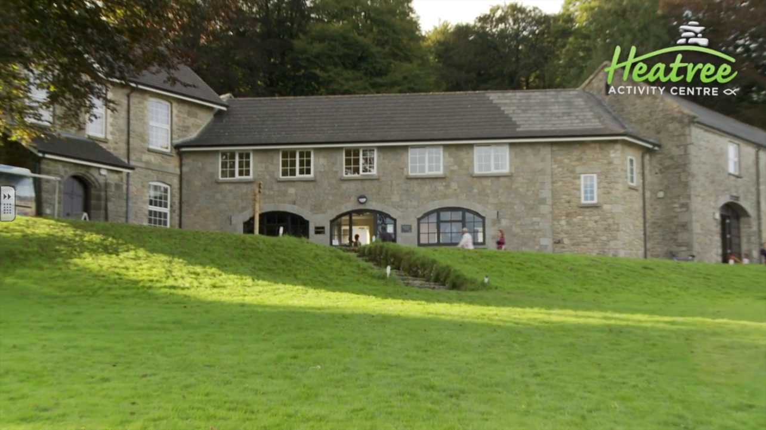
Heatree Information Evening

Slide 2
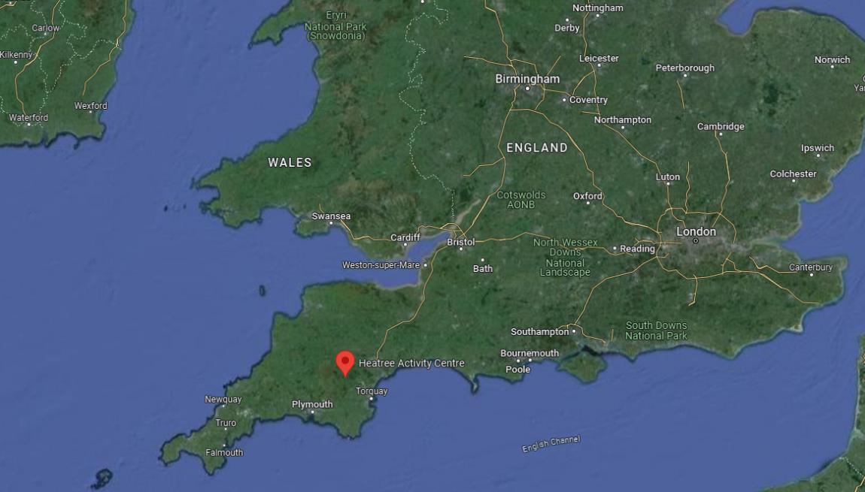
Monday 6th July – Friday 10th July 2026
Heatree Activity Centre
Manaton
Devon
TQ13 9XE

Slide 3
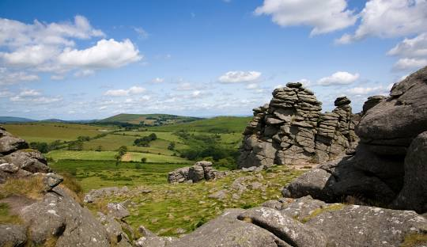
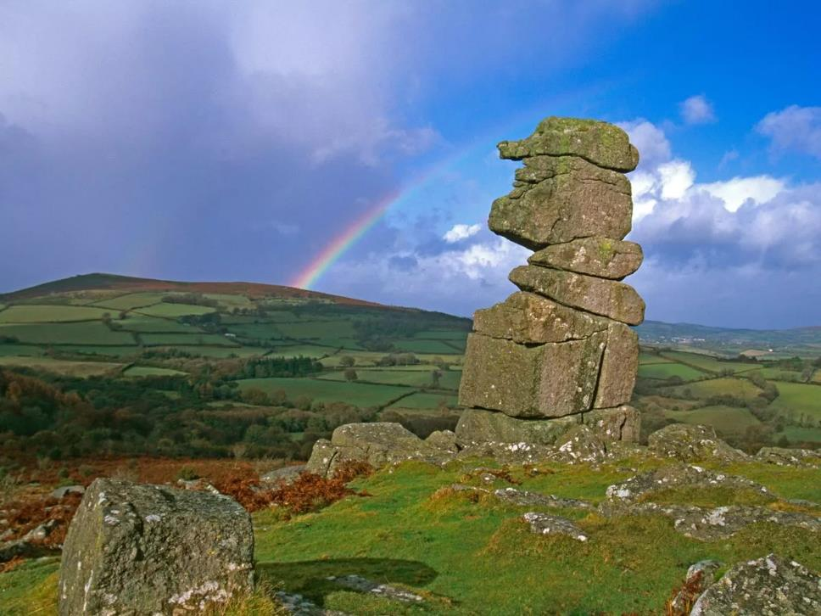
Located in Dartmoor National Park

Slide 4
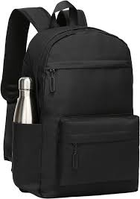
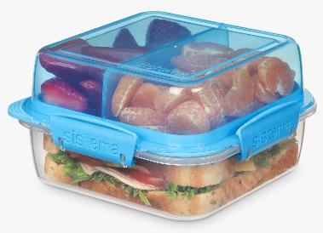
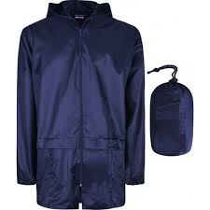

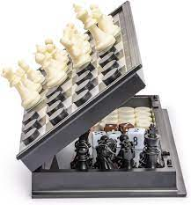

Monday 6th July 2026
For the coach journey, your child must have the following in their rucksack:
A waterproof jacket
An appropriate substantial snack
A packed lunch
A reusable water bottle
Activities to engage them during the journey (No electronic games or devices)
Meet at school at 7:00am
The coach will be leaving by 7:20am
We cannot wait for anyone who is late.

Slide 5

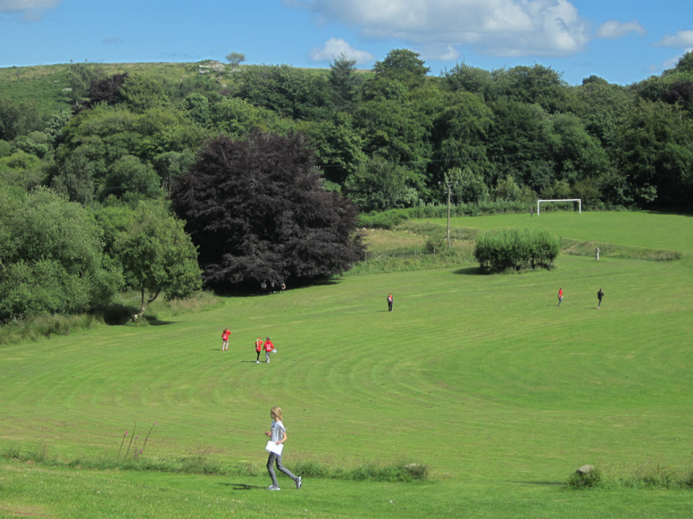
The Centre
Heatree is a Christian activity centre. Tenax have booked the whole site for the duration of our stay.
There are large outdoor spaces, including a football pitch and a area to play cricket or rounders.

Slide 6
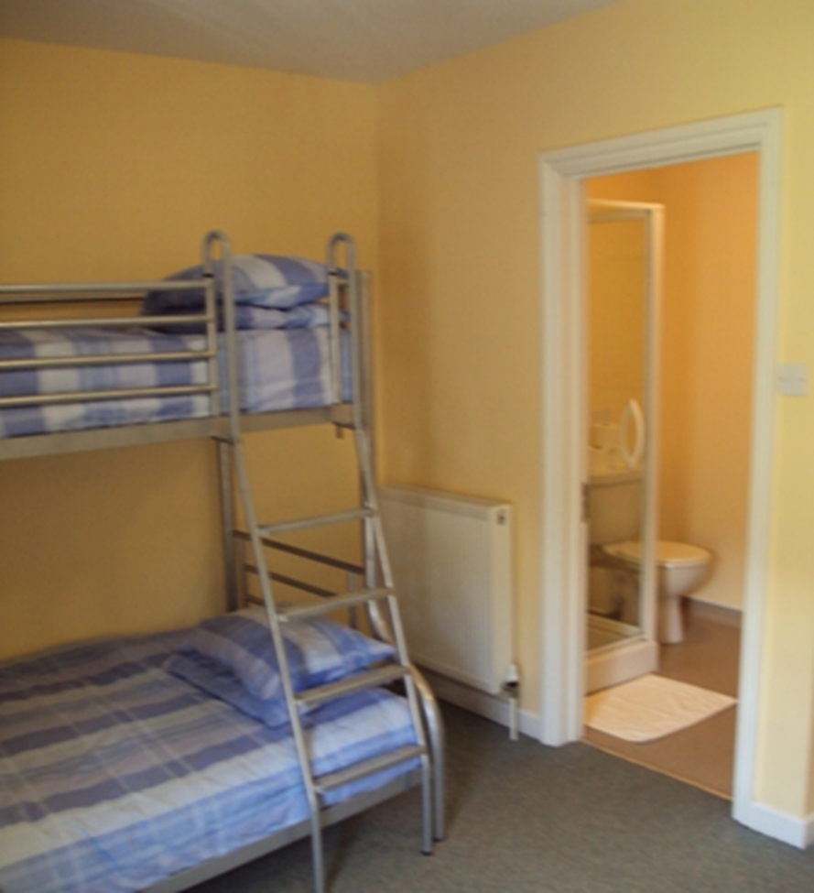
Accommodation
The rooms can sleep up to 6 children and have en suite bathrooms.
Your child will need to bring a duvet cover and pillow case, which they will use to make the bed when they arrive.
In May, after SATS, the children will identify who they would most like to share a room with. This will be used to support room allocation.
Please note, we do not share room allocations until we arrive on the day. This is to avoid disappointment should we have to make any last minute changes.

Slide 7
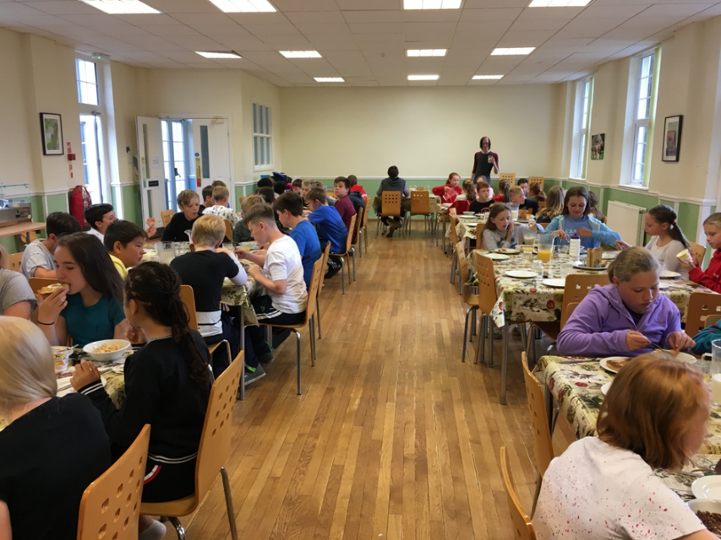
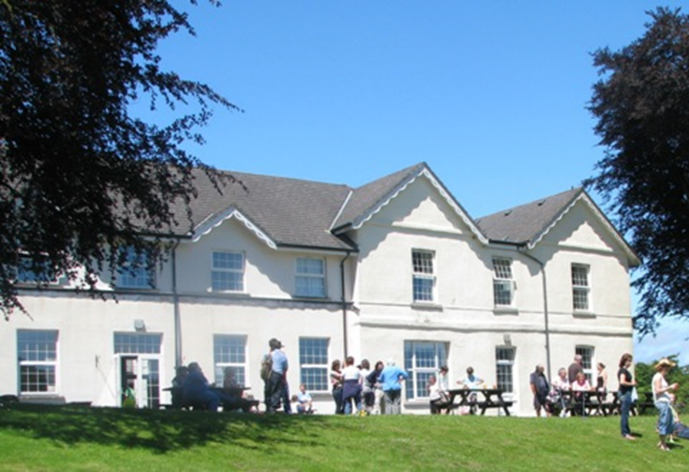
Meals
Breakfast; including toast, a range of cereals, yogurts and fruit.
Packed Lunch; your child will select what they would like the evening before.
A Hot Dinner; including vegetarian options and a pudding.
Evening Snack; e.g. flapjack, shortbread, cake…
Please do not pack any additional food in your child’s luggage! They only need their snack and a packed lunch on the Monday.

Slide 8
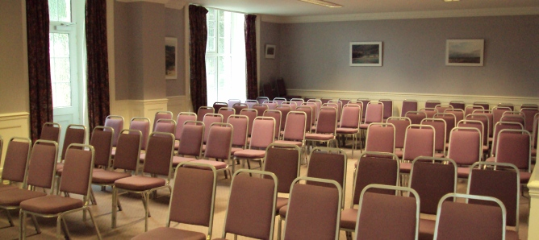
Morning and Afternoon Briefings
At key points during the day, we will hold short briefings to ensure the children know what is happening next and what they need to do to prepare.

Slide 9
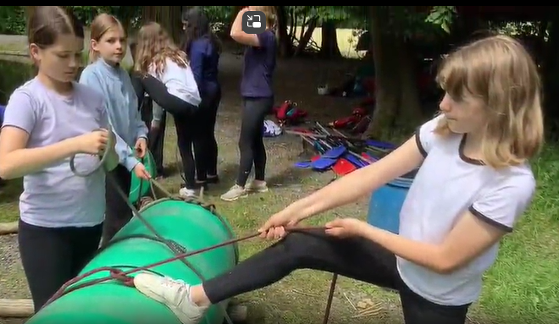
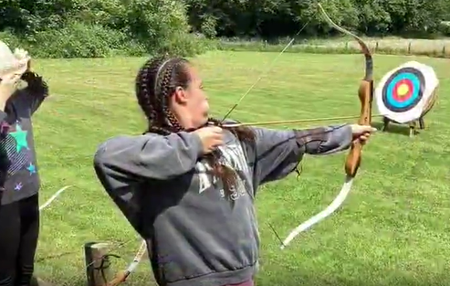
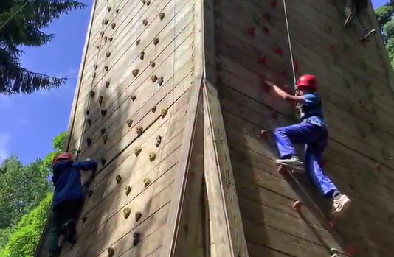
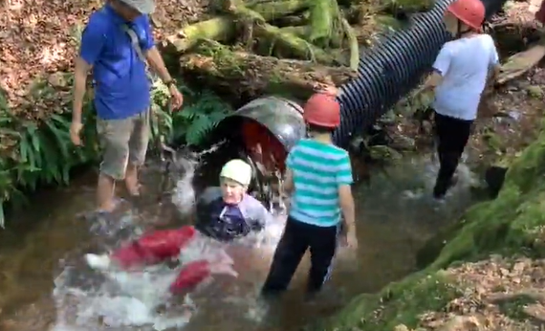
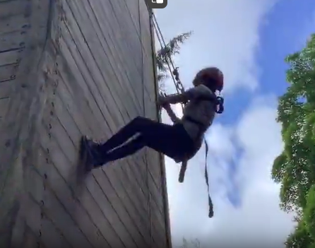
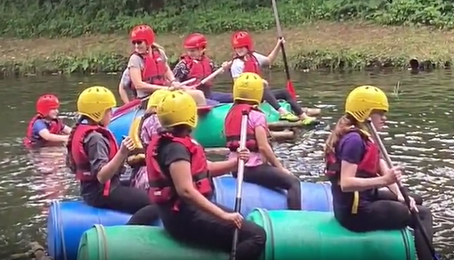
Activity Program
Although the activities are not yet confirmed, we have selected an active program.

Slide 10
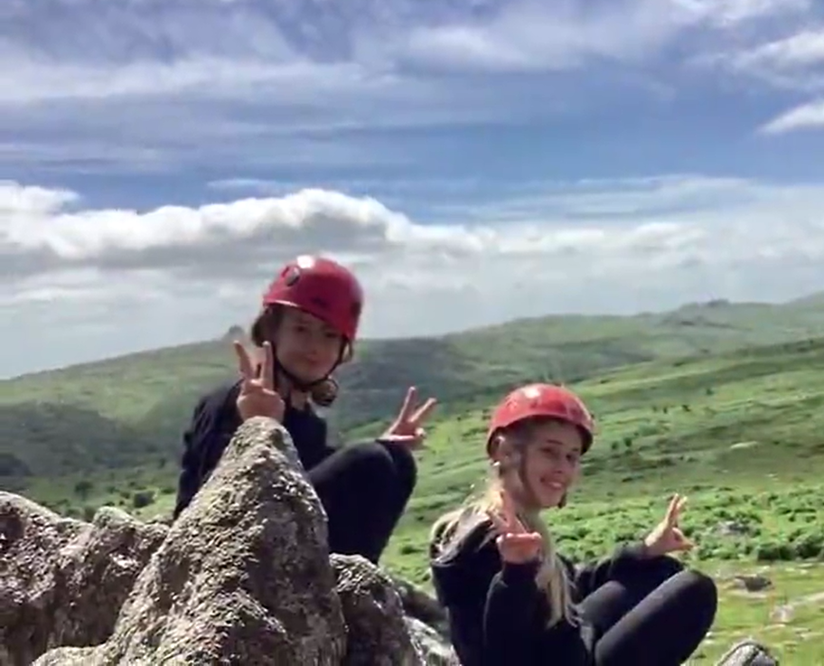
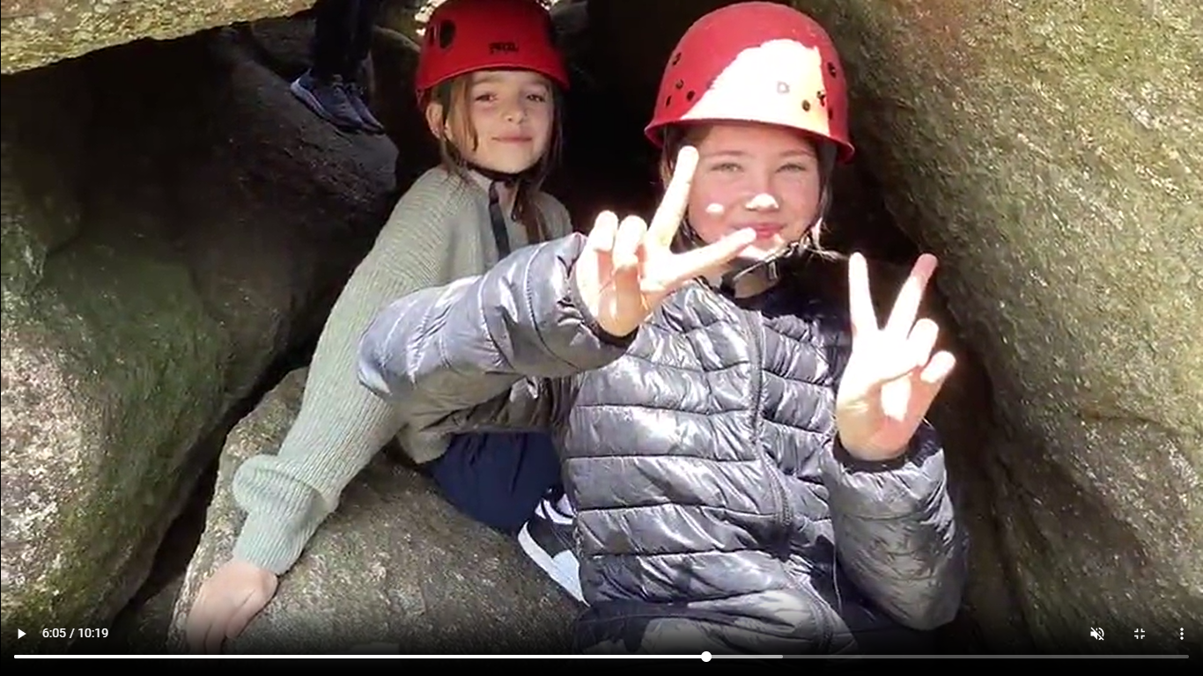
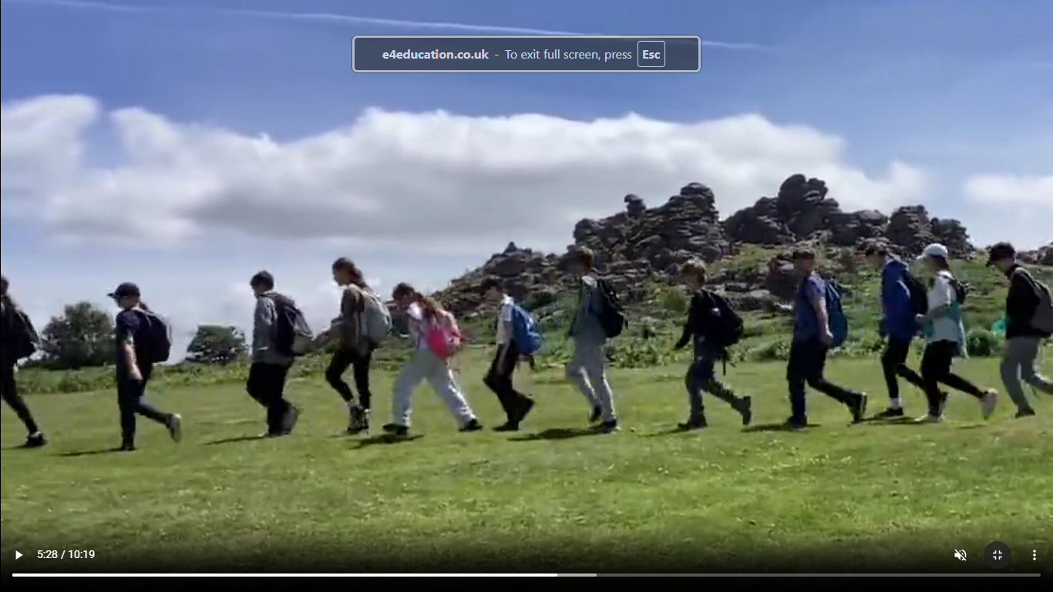

Activity Program
This will include a day on the moors.
Details of what your child needs to wear can be found in the kit list.
It is really important that you ensure your child has long trousers and appropriate footwear.

Slide 11
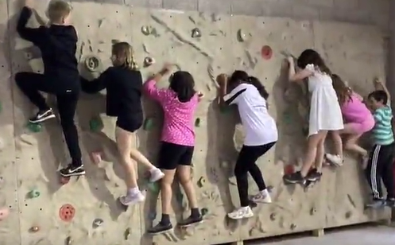
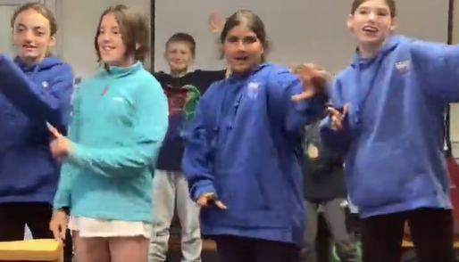
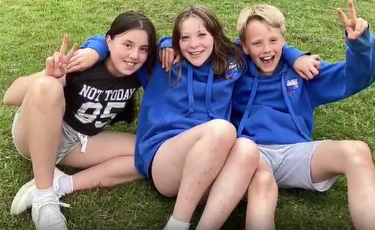
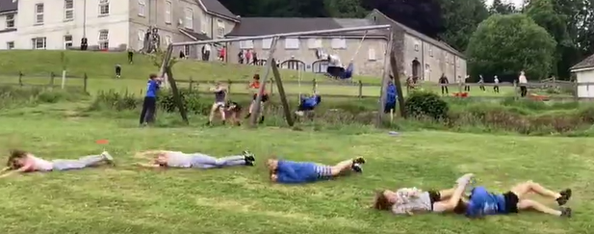
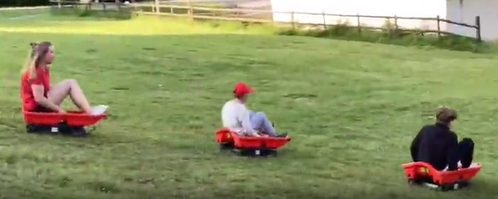
Evening Activities
Our school team will arrange a program of evening activities designed to keep the children engaged until bedtime.

Slide 12
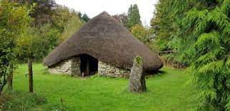
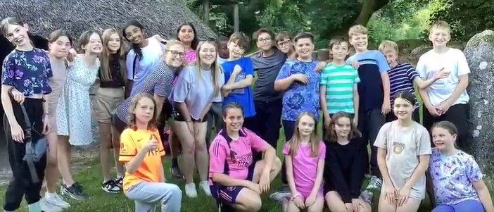
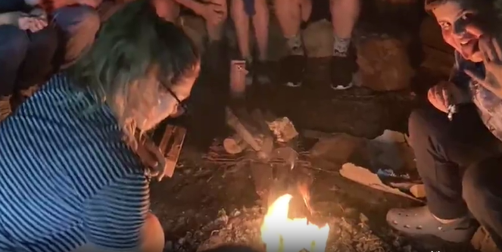
The Roundhouse
During one evening, the classes will visit Heatree’s roundhouse to toast marshmallows, sing songs and tell jokes.

Slide 13
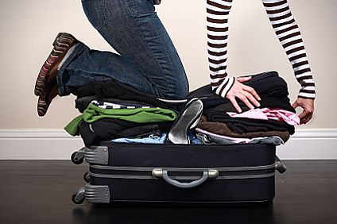
Important Messages
Use the kit list to help you decide what to pack.
Make sure everything is clearly labeled.
Ensure your child knows how to repack the bag at the end of the stay. (We will be on hand to support, but cannot repack for them.)
Do not put any food or medication in your child’s luggage.

Slide 14


Medical Information and Medications
You must complete and return your signed medical form by Friday 1st May 2026.
Ensure you include information about any personal needs your child might have.
All information will be treated as highly confidential!
Medications must be delivered to the school office, during the week commencing Monday 29th June.
They must be clearly labeled and in their original packaging.
To avoid our team being overwhelmed, please only send medication that your child really needs.

Slide 15
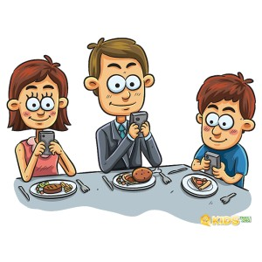
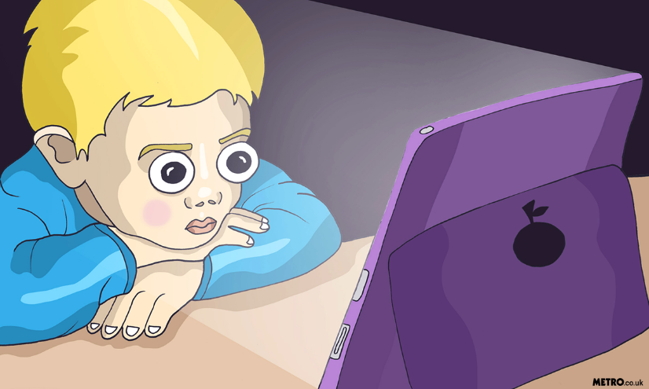
Electronic devices are not permitted on the trip under any circumstances.
Warning: Time away from devices could result in increased face to face socialising, connecting with friends, lower levels of stress, improved sleep and discovering that the real world was also made in HD!

Slide 16

Updates and Photos
Each day, we will post an update on the class webpage so that you can see the exiting things we have been doing.
An exact link to this page will be sent out the week before we travel.
Each group leader will also have a camera with them, that they will use to take photos during our time away. When we return to school, these will be uploaded to a remote part of our website for you to view and download.
If you do not want your child to be included in this collection, you must contact Miss Scott in writing by Monday 13th June so she can ensure the team are aware.
(If your child does not have photographic consent, they will automatically not be included unless you update their photographic permissions before the above date.)

Slide 17

Further Information
If you would like to learn more about the centre, please visit Heatree’s website:
www.heatree.org
To get a further flavour of what the trip will be like, you could view the video montage from our school last year!
Bishop Chavasse Primary School - Heatree 2024 - Year 6 residential

