Slide 1
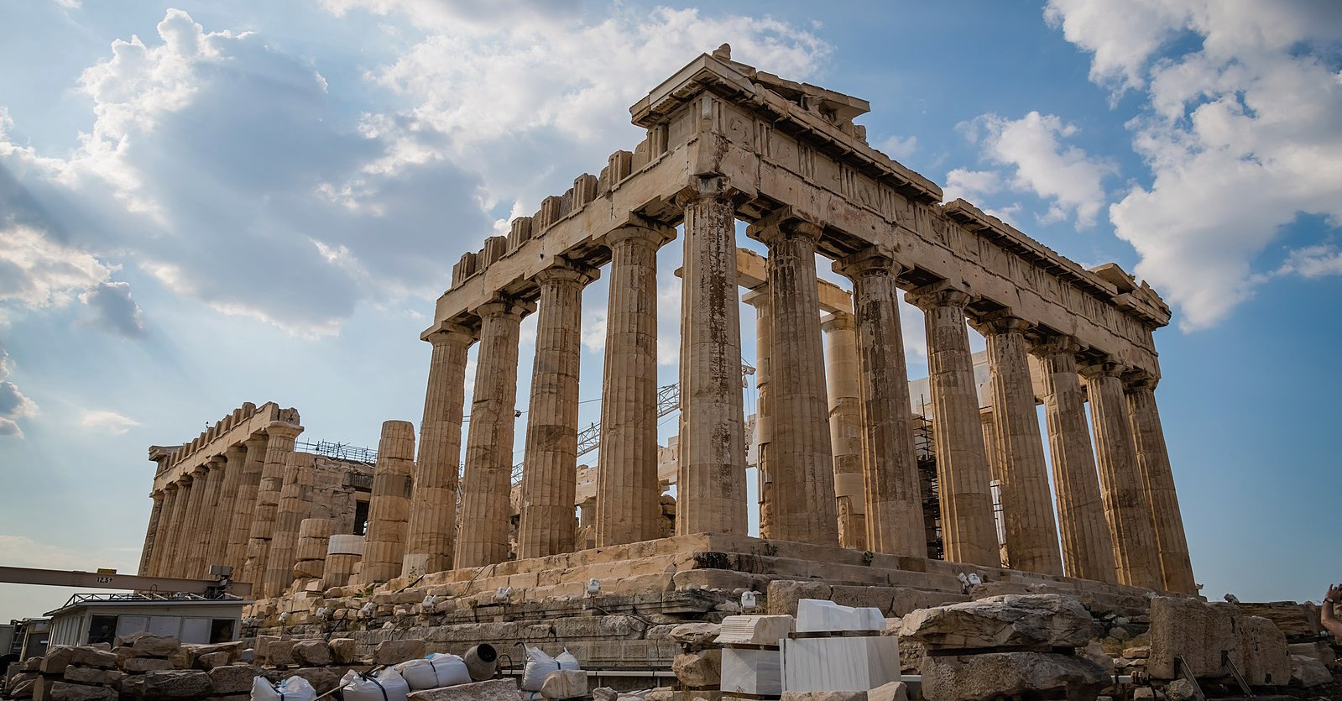
English
Our book for this term is Pip and Egg by Alex Latimer. Children will be writing their own transformation narrative. Children will continue to use conjunctions and expressing time and place using adverbs.
History
Our topic is our Persia and Greece. We will be learning about how the empires developed, about their rulers their beliefs and gods about their wars and language.
Maths
We will be learning this term with fractions: introducing and learning about types of fractions. We will also be learning about measurement and volume.
Latin
Our topic is called 'the best days of your life' in which we will revise different Latin verbs and adjectives.
Music
In music this term we will continue learning the ukele. The children are progressing well and are working towards a performance later in the year.
Religious Education
In RE this term the children will be learning about Salvation. We will be learning about the events of Holy Week leading up to the Crucifixion story and how Christians believe Jesus rose from the and how this is fundamental to Christian belief.
Persia and Greece
Geography
Our topic for this term in Geography is agriculture and the challenges involved with different types of agriculture. We will be learning how farming changes and can maintain landscape and where food comes from.
Science
We will be learning about Animals including Humans. We will look at how we keep our bodies healthy, what food do humans needs, as well as how do our muscles work?
Art and Design
Our topic for DT is cooking. We will be looking at creating a seasonal tart. The children will use peelers and knives to chop and prepare their seasonal vegetables before baking.
PE
Our focuses for PE this term are 'cricket' and 'balance and strength'.
Computing
Our computing topic will be about emailing, We will learn about methods of communication, how to email safely, how to respond to an email and add attachments.
RHE
This term our unit is called Healthy Me. We will be thinking about exercise, healthy eating and how to take care of our bodies.

