Slide 1

Bishop Chavasse C of E Primary School
Writing Workshop
27th January 2020

Slide 2
The purpose of this workshop
To gain an understanding of how children’s writing develops.
To understand how we teach writing here at Bishop Chavasse.
To know how we teach some of the technical aspects of writing.
To enable you to sample a BCS English lesson
To give you some practical ideas about how you can support your children at home with their writing.

Slide 3
‘Meagre reading produces thin writing’
The most proficient writers in any class are always the readers’
‘We need to stimulate an interest in words and sentences because they lie at the root of all writing’
‘If you want to be a writer then read, read, read.’’
‘Writers read deeply’
We only write when it matters to us personally’
‘Writing is about who we are. It is particular and
personal and individual.’

Slide 4
Writing =Transcription and
Composition
Transcription = Spelling and Handwriting
Composition =
Planning
Drafting
Evaluating
Sharing
Revising and editing
Sentence combining
Summarising
Writing for a purpose and an audience
Grammar and punctuation

Slide 5
The writing journey
As soon as your child starts to make marks, they are writers.
Writing is a developmental process; a journey.
The different stages of this journey are described briefly in the following slides

Slide 6
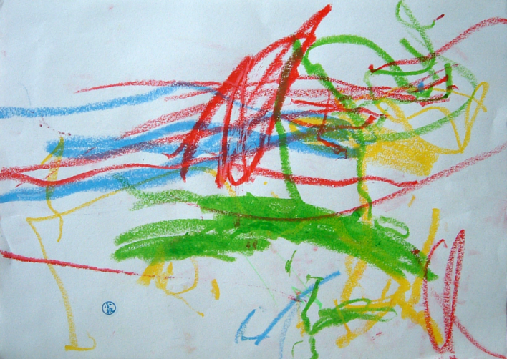
Mark Making
‘Mark Making’ looks like random assortment of
marks on a child's paper.
Sometimes the marks are large, circular and random. Sometimes they resemble drawing.
Although the marks do not resemble print, they are significant because the young writer uses them to show ideas and can talk about them

Slide 7
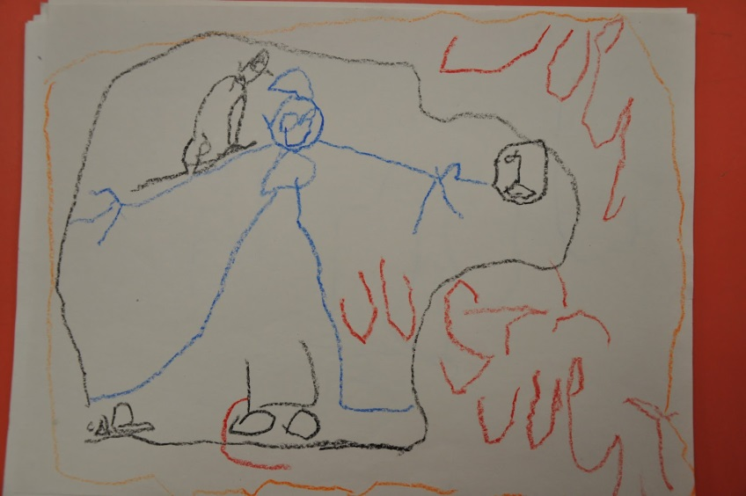
Letter-like symbols
Letter-like forms emerge, sometimes randomly placed and often interspersed with numbers.
The children can talk about their own ‘writing’. In this stage, spacing is rarely present

Slide 8
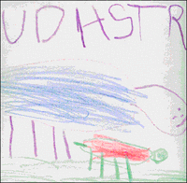
Strings of letters
In the ‘strings of letters’ phase, children write some legible letters that tell us they know more about writing. They will often use letters from their names.
Children are developing awareness of the sound-to-symbol relationship, although they are not matching most sounds.
Children will often write in capital letters and have not yet begun spacing.

Slide 9
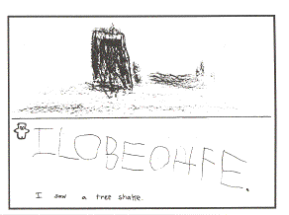
Beginning sounds emerge
At this stage, children begin to see the differences between a letter and a word, but they may not use spacing between words.
Children are beginning to match some sounds to symbols.
Their message makes sense and matches the picture, especially when they choose the topic.

Slide 10
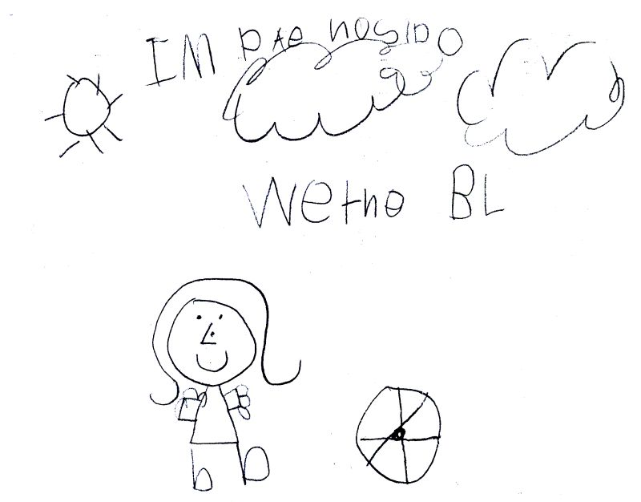
Consonants represent words
Your child begins to leave spaces between their words and may often mix upper and lowercase letters in their writing.
Usually they write sentences that tell ideas

Slide 11
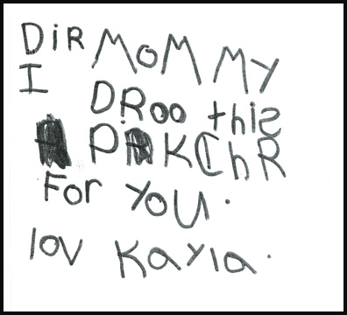
Initial, middle and final sounds
Children in this phase may spell correctly some sight words, familiar words and names, and environmental print. Other words are spelled the way they sound.
Their writing is readable

Slide 12
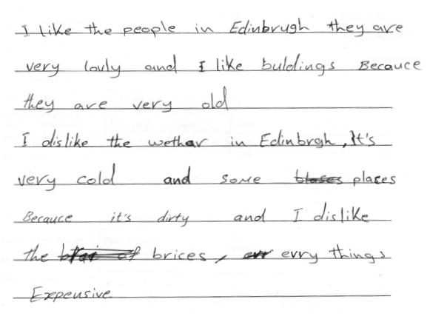
Transitional Phase
This writing is readable and approaches conventional spelling.
The writing is interspersed with words that are in standard form and have standard letter patterns

Slide 13
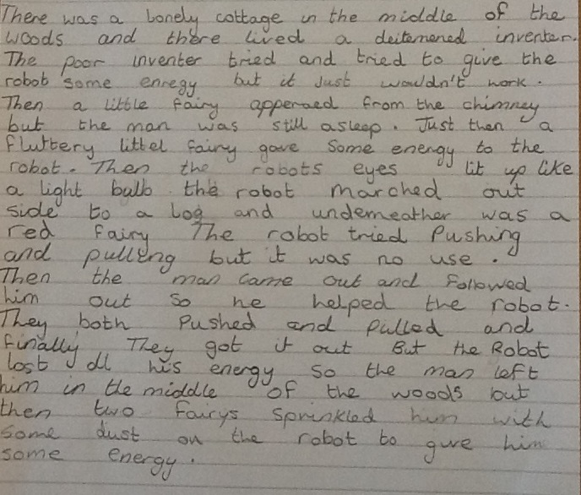
Standard spelling
Children in this phase can spell most words correctly and are developing an understanding of root words - a basic word without a prefix or suffix added to it e.g. normal = abnormal and normality, compound words- inside, outdoors, however and contractions- and, but, so because. This understanding helps them to spell similar words

Slide 14
Your child as a writer
Needs to:
have ideas of what to write
• hold these ideas in their head
• need to control a pencil or pen
• try to get letters round the right way and the right way up
• try to match the right sound to the right letter/s
• keep the handwriting even and legible
• think about word order and grammar
• get the punctuation right
• try and use the best words in the best place
• and that is just a start!!

Slide 15
The success of children’s ability to write is based on:
A rich talking environment.
Experience of many stories that have been read to them.
Being able to join in with stories and adding their own ideas.
Practising and developing their own story language - ‘talking like a book’.
A range of engaging speaking and listening activities related to drama.

Slide 16
Creating Writers at Bishop Chavasse- Our Intent
At Bishop Chavasse we believe that a high quality Literacy (English) curriculum should develop our children’s love of reading, writing and discussion. We aim to inspire an appreciation of our rich and varied literary heritage and a habit of reading widely and frequently. As a school we recognise the importance of nurturing a culture where children take pride in their writing, can write clearly and accurately and adapt their language and style for a range of contexts. We strive to inspire all children to be confident in the art of speaking and listening and use discussion to communicate and further their learning.
We believe that
children need to develop a secure knowledge-base in Literacy, which follows a clear pathway of progression as they advance through the primary curriculum.
a secure basis in literacy skills is crucial to a high quality education, which provides our children with the necessary tools they need to fulfil their potential throughout their school years and beyond.

Slide 17
Our Implementation – the How
These aims are embedded across our literacy lessons and the wider curriculum. We have an English curriculum that provides many purposeful opportunities for reading, writing and discussion. Teachers adapt the CLPE Power of Reading Scheme as appropriate to their classes, but also ensure that cross curricular links with concurrent topic work are woven into the program of study. Our curriculum closely follows the aims of the National Curriculum for English 2014.

Slide 18
The national curriculum for English aims to ensure that all pupils:
● read easily, fluently and with a good understanding
● develop the habit of reading widely and often, for both pleasure and information
● acquire a wide vocabulary, an understanding of grammar and knowledge of linguistic conventions for reading, writing and spoken language
● appreciate our rich and varied literary heritage
● write clearly, accurately and coherently, adapting their language and style in and for a range of contexts, purposes and audiences
● use discussion in order to learn; able to elaborate and explain clearly their understanding and ideas
● are competent in the arts of speaking and listening, making formal presentations, demonstrating to others and participating in debate.
In addition to daily literacy lessons, we use a wide variety of quality texts and resources to motivate and inspire our children. Our text rich learning environment ensures that our children are exposed to a library admired by all, as well as our additional reading facilities which promote reading for pleasure for the whole school community.

Slide 19
What we do at Bishop Chavasse
Daily reading and writing opportunities
Extended writing opportunities in English and other subjects
Frequent, discrete handwriting sessions
Daily phonic sessions
Daily writing opportunities
Daily story time
Drama opportunities
Using a variety of stimuli – puppets, visual and audio stimulus
Oral rehearsal and oral revision (before and after writing)
Time to up-level previous writing and improve

Slide 20
What we teach
Using adventurous and wide-ranging vocabulary
Using a clear structure to organise writing
Using texts read as models for writing
Sequencing events and recount them in appropriate detail
Varying writing to suit purpose and reader
Putting ideas into sentences – grammar and punctuation
Having a positive, confident attitude to writing

Slide 21
What we do…
Demonstration – I’ll show you how to do something
Joint composition – now we’ll have a go together
Guided Writing – I’ll support you in a small, focused group
Independent writing – you have a go on your own
And now it’s your turn

Slide 22
The end result- The Impact
First and foremost, our pupils are given opportunities to explore and investigate the English language and its patterns through speaking and listening. As pupils move through EYFS and Key stage 1, they develop, consolidate and secure the skills needed to read, share, enjoy and interpret a wide variety of literature. This will continue as the school grows into Key Stage 2.
Our pupils are taught challenging, age-appropriate content, due to our expectation that the vast majority of our pupils will achieve at least age-appropriate expectations at the end of each year and key stage. As a result we have a community of enthusiastic readers and writers who enjoy showcasing their developing literacy knowledge and skills. They are confident to take risks in their reading and writing, and love to discuss and share their ideas.

Slide 23
Helping at home- Remind your child:
Read, Read and Read!
Practise reading out your writing aloud
Writers concentrate fiercely on their work
Keep self-image high and positive
Creativity matters because it makes us all feel special
To write about anything and everything- shopping lists to song lyrics, stories to postcards…
Children should enjoy writing!

Slide 24
Remember
You can’t write a story unless you can tell a story, and you can’t tell a story unless you have heard a story.

Slide 25
Create a literature-rich, word loving home
Enjoy our school library and visit the Tonbridge library.
Read aloud and listen to audiobooks together.
Encourage independent audiobook-listening if your child can’t yet read, or doesn’t enjoy reading.
Teach your child fairy tales and nursery rhymes.
Have deep discussions about books and films–not based on someone else’s “comprehension questions,” but on your own wonderings.
Tell stories. Read and recite poetry. Engage in word play: rhyming games, jokes, puns and riddles,
verbal poetry composed on the spot, and so on
Use letter sounds and not letter names
Write in lower case letters
Encourage your child to recognise letters in their environment; street names, signs, packets, brand labels

Slide 26
Talk about what interests your child
Let them go on and on about dogs or science or history or Dr Who if that’s what excites them. Ask questions. Let them explain in intricate detail.
Have discussions. Ask for their opinion on important, real-world issues. This will develop their skills of explanation and argument, which will eventually factor into their writing
Enjoy debate around the dining table, discuss local and national news.

Slide 27
Let your child write about what interests them, and in genres that they enjoy
If your child is mad about space, Moshi Monsters or Hatchimals– respect their interest: this what they know and this is what will excite them. This is what will make their writing vivid and detailed.
If they want to write fantasy stories because they love Harry Potter, they will understand how the genre works. We have to make the act of writing engaging –to draw children in and to make them want to continue. This will lead to self-sponsored writing projects.

Slide 28
Help your child find meaningful, authentic reasons to write
Generally, we write to communicate with others.
We write to connect.
Find real writing opportunities that engage your child and invite responses e.g. letters and e-mails, invitations, shopping lists etc.

Slide 29
To become writers, our children need something to say, the means to say it, and a reason to say it. As parents and educators we are the ones who have to inspire this.

