Slide 1

SEND at Bishop Chavasse School

Slide 2
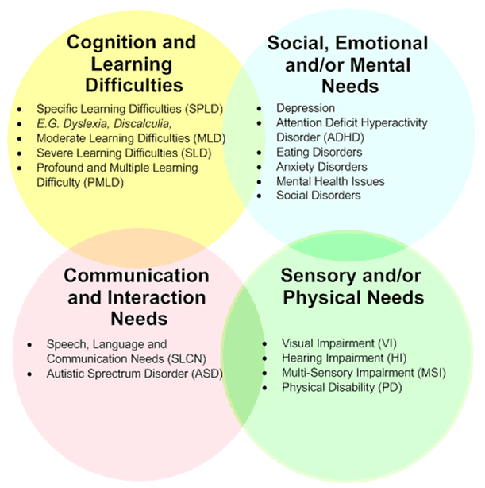
The 4 areas oF SEND

Slide 3
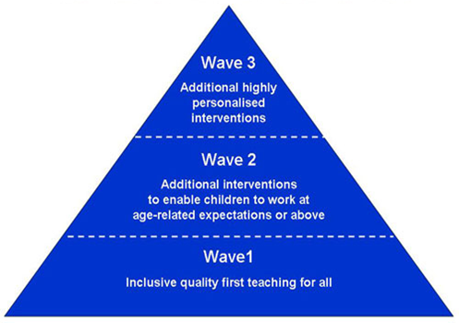
Graduated Response to SEN
Personalised Plan or EHCP.
Support from external professionals.
May have additional adult support.
A number of interventions (time limited).
May have a Personalised Plan in place.
May be supported by external professionals.
Linked to the Mainstream Core Standards.
Approaches used to form our universal offer.
May have one or two interventions.

Slide 4
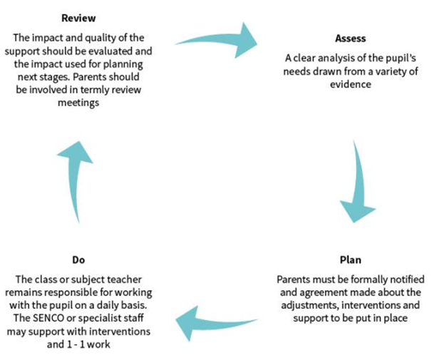
Assess, Plan, do, review cycles
Reviews held three times a year followed by a parent meeting with the SENDCo.
Monitoring of the effectiveness of interventions and additional support.
Review the impact and set new targets when previous targets have been met.

Slide 5
External agencies & referrals
- Community Paediatrics (Neurodevelopmental assessments: ASD assessment, ADHD assessment, assessment of learning difficulties or global delay).
- School nursing team: Toileting, eating/ diet, sleep difficulties.
- CHYPMHS/ SPA: Neurodevelopmental assessment: ADHD assessment, ASD assessment (over 11s only). Mental health support: e.g. cognitive behavioural therapy, support with anxiety, self-harm, etc.
- Speech and Language Therapy
- Occupational Therapy
- Physiotherapy
- Early Help
- Other specialist services, such as, Dandelion time.
- Play Therapy and Talking and Drawing Therapy are offered within school.

Slide 6

Specialist teaching and learning service
Cover the 4 areas of SEND as well as Early Years.
Require 2-3 terms of reviewed personalised plans.
Surgeries held for each area each half term where children are discussed anonymously (unless for SLT).
Put recommendations in place then attend second surgery.
Can then request for the child to be ‘seen’ at LIFT (Local Inclusion Forum Meeting).
The team will decide whether to take the child onto their case load or make further recommendations.

Slide 7
Hearing and visual impairments
Different process for children with Hearing and Visual Impairments as these children often join us with needs identified and will be likely to receive support already in their Early Years settings.
HI and VI specialist teachers provide support once a term:
- Specialist assessments
- Recommendations for further support/ resources, e.g. Kent Association for the Blind
- Arrange specialist equipment, e.g. Assisted Listening Devices, magnifying visualisers
- Conduct environmental assessments

Slide 8
Education and Health Care plans (EHCPs)
Criteria 1: Is attainment below the expected range compared to peers born in the same term as them?
Criteria 2: Has the child not made expected progress or only made expected progress as a result of a high level of intervention and support?
Criteria 3: Are we (the local authority) of the opinion that the child or young person has or may have special educational needs which may require the support of an EHC plan?
Criteria 4: Has the education setting taken relevant action to identify, assess and meet the child or young person’s special educational needs, including making full use of its set funds and additional spending above this level?

Slide 9

If the answer to all four questions is yes, the LA will assess your child or young person's EHC needs.
If any of the above criteria are not met, the LA will ask whether there is evidence of other circumstances which mean the child or young person should be assessed.
The LA would usually only assess if there are special circumstances that justify this.
Submit application
Agree to assess
Decline to assess
Decline issue of EHCP
Agree to issue EHCP
Appeal
Gather further evidence
Meet needs without EHCP
Gather further evidence and reapply
Appeal (tribunal)
Reapply

Slide 10
https://www.kent.gov.uk/__data/assets/pdf_file/0005/125717/Request-an-EHC-plan-process-map.pdf
Draft plan issued. Meeting with SENDCo to discuss and request any alterations.
Request alternative setting.
Local Authority will consult with parents’ chosen school/s.
Final EHCP issued.
Annual review.

Slide 11
High Needs Funding (HNF).
Demonstrate a significantly high level of support is needed (three cycles).
Demonstrate spending above the £6,000 notional budget.
Application process.
Banded system according to area/s of need.
Must be applied for annually; demonstrate impact and progress.
HNF paid to schools monthly and follows the child.
Recruitment and training.

Slide 12
Transfer from primary to secondary
Date | Event/ action | Responsible
Year 5 Term 1 & 2 | Discuss secondary options available. Parents arrange school visits. Conversation with secondary SENDCo in addition to attending open evenings. Application window for all. District to agree common transition dates and events. | Primary SENDCO, parents, other professionals, STLS, Health Parents, primary and secondary SENDCOs, STLS
Year 5 Terms 1-6 Term 6 | Annual reviews: state preferred school on paperwork. Further transition visits. Primary schools will receive a form to be distributed to parents for parents to indicate a preference. | Primary SENCO, parents, STLS Local Authority, primary SENDCO, parents
Year 6 Term 1 | Form to be completed and returned by the date indicated on the form. | Parents/carers
Year 6 Term 2 | LA to allocate all children with an EHCP a secondary placement. | KCC SEND
Year 6 Terms 3 & 4 | Primary and secondary SENDCo formalise transition arrangements. | Primary SENDCO, secondary SENDCO, other professionals
Year 6 Terms 5 & 6 | Transition programme to be delivered in accordance with transition charter. Transfer of files (SEND and safeguarding). | Primary SENDCO, Primary DSL, Secondary SENDCO/ transition lead, secondary DSL
Year 7 Terms 1 & 2 | On-going transition programme to ensure children settle into new placements successfully. | Secondary SENDCO and transition lead, other professionals where appropriate

Slide 13
Progression of Provision for SEND
- Speech and Language Link assessments on entry to the school
- Kent Inclusion Leadership Programme
- Educational Psychologist
- Ongoing training delivered to teachers and support staff; weekly TA meetings
- Kent Nurture Programme
- Anxiety Based School Avoidance (ASBA)
- Autism Education Trust (AET)
- Premature Birth Information for Educational Professionals
- Speech and language TA
- Bell Foundation

Slide 14
Further information and support
School website:
  SEND policy
  https://padlet.com/abdullah87/send-at-bishop-chavasse-school-67xngbzbph9apjv0
  SENDCO email address: sendco@bishopchavasseschool.org.uk

