Slide 1
Year 3 and 4 Multiplication Tables Check 2023
Information for Parents, Carers & Guardians

Slide 2
Importance of times tables
Maths is a big subject and a lot of the rich, interesting areas of maths is all about the multiplicative relationships, but these are hard to fully grasp without fluent recall of the tables.
For that reason, learning the tables is fundamental – they are a key facilitator to the maths that sits on top.
A fluent recall of times table facts facilitates a quicker understanding of other topics within maths such as fractions, decimals, percentages algebra, ratio and proportion.
The checks are all about remembering the multiplication facts, but this goes hand in hand with the concepts, patterns, structures and relationships in multiplication and this is included in how we teach them – we will share some of these ways later.

Slide 3
Within Bishop Chavasse School:
The checks are administered in pretty much the same way as one of the ways we practise the times tables, so when the children do the actual check, it won't seem very different to them.
Tests in themselves don’t cause anxiety. It’s the perception of not doing well, for that reason, we will downplay the checks with the pupils,
We are focus on times tables for the benefit of their wider maths education, not for them to get a high score on the tests!

Slide 4
Important information about multiplication tables check (MTC)
The MTC determines if Year 4 children can fluently recall their multiplication tables.
They are designed to help schools identify which children require more support to learn their times tables.
There is no ‘pass’ rate or threshold which means that children will not be expected to re-sit the check.
The Department for Education (DfE) will create a report about the overall results across all schools in England, not individual schools.
Notes:
The test is designed to identify pupils who need support, not as a diagnostic tool to assess the times tables children struggle with.

Slide 5
When the check will take place
There will be a 2 week window from Monday 5th June and Friday 16th June 2023 for schools to administer the check.
There is no set day to administer the check and children are not expected to take the check at the same time.
All eligible Year 4 children in England will be required to take the check.
Notes:
It is up to individual schools to decide how the check is administered – some schools will administer individually while others will take small groups out or administer to the whole class.
A list of pupils who should not take the test can be found in the administration guidance of the MTC documentation.

Slide 6
How the check is carried out
The check will be fully digital.
Answers will be entered using a keyboard, by pressing digits using a mouse or using an on-screen number pad.
Usually, the check will take less than 5 minutes for each child.
The children will have 6 seconds from the time the question appears to input their answer.
There will be a total of 25 questions with a 3 second pause in-between questions.
There will be 3 practice questions before the check begins.
Notes:
Some children will be eligible for additional support (detailed in the next slide).
6 seconds per answer means that children must be able to read, recall and enter their response within that time. Whatever is written in the answer box at the end of 6 seconds will be counted as the answer i.e. if the student intends to write 144 and only 14 is typed when the timer ends, their recorded answer is 14.
Children are allowed to practise before taking the check.
https://mathsframe.co.uk/en/resources/resource/477/Multiplication-Tables-Check example showing how quick the questions are/ types of questions.

Slide 7
Specific arrangements for the check
Some children will be eligible for specific arrangements:
Colour contrast;
Font size adjustment;
‘Next’ button (alternative to 3-second pause);
Removing on-screen number pad;
An adult to input answers;
Audio version;
Audible time alert.
Notes:
Children eligible for access arrangements are:
Children with an EHC plan
Children who have provisions made in school using the SEND support system.
Children with behavioural, emotional or social difficulties
Children with EAL
Schools do not need to request permission to use access arrangements. The support should be based on the support provided in school and should not advantage or disadvantage individual children.
A child can be assigned more than one access arrangement, if required.

Slide 8
The check questions
Each child will be randomly assigned a set of questions
There will only be multiplication questions in the check, not division facts.
The 6, 7, 8, 9 and 12 times tables are more likely to be asked.
Reversal of questions (e.g. 8 x 6 and 6 x 8) will not be asked in the same check.
Children will not see their individual results when they complete the check.
Notes:
Some questions will be repeated across different checks, but no more than 30% of questions will be repeated in any two checks. This means that if the check gets interrupted and children need to re-start it, they will only have a minimal advantage.
During the check pupils may be able to restart if certain conditions are met (e.g. a fire alarm).
The results will be sent to the schools when all the checks have been completed but it is then up to the school if they report the results or not.
There won’t be questions from the 1 times tables (although they might be included in the 3 practice questions).
There will be a maximum of 7 questions from the 2, 5 and 10 times tables.
There is a focus on the 6, 7, 8, 9 and 12 times tables as they are the ‘most difficult’ multiplication tables.

Slide 9
Ways to support times table knowledge
Count and look for patterns.
Understand that multiplication is repeated addition.
Remember that multiplication is commutative.
Remember that multiplication is the inverse of division.
Recall and utilise number families.
Use different representations to represent multiplication, such as:
Concrete manipulatives suck as multilink cubes or counters.
Create pictorial representations such as arrays.

Slide 10


Repeated addition
Knowing that 2 x 4 is the same as 2 + 2 + 2 + 2
2 + 2 + 2 + 2 = ?
2 x 4 = ?
Notes:
Children need experience of using concrete manipulatives such as counters or multilink cubes and pictorial representations of objects, forming arrays.

Slide 11


Multiplication is commutative
3 x 2 is the same as 2 x 3
Children need to understand that multiplication can be completed in any order to produce the same answer. Sometimes this link needs to be made explicit.
3 lots of 2 = 6
2 lots of 3 = 6
Notes:
Children build on their existing understanding using arrays, turning the arrays around to show that you now have 2 groups of 3 and they will still total 6. This can then be linked to recalling multiplication facts, e.g. if they know their 2 times table as facts but not their 3 times table, they can use 2 x 3 to work out 3 x 2.

Slide 12

Multiplication is the inverse of division
20 ÷ 5 = 4 can be worked out because 5 x 4 = 20
Using pictorial representations (such as arrays) is useful here for children to see the link between multiplication and division.
Notes:
Even though division is not tested in the MTC, it is important that pupils have a strong understanding of the connection between multiplication and division.
Again, the use of arrays is key. Children need experience of pulling arrays apart into groups or sharing. After basic experience has been gained, the children should start to ‘see’ an array structure as 5 groups of 4 equal 20 and 20 can be split into 5 groups of 4.

Slide 13
Number families
4 x 5 = 20, 5 x 4 = 20, 20 ÷ 5 = 4, 20 ÷ 4 = 5
Due to their commutative understanding, children should also be able to see whole number families. For many children this will need to be pointed out and discussed.
20
4
5
Notes:
From here it is only a short jump to understanding that any missing number can be worked out through knowledge of number families, e.g. 4 x [ ] = 20 or [ ] ÷ 4 = 5. There are other methods children can use to work out missing numbers but our goal is to increase working memory in order to increase instant recall from long term memory. Being able to bounce around a number family will achieve that.

Slide 14
Using known facts
4 x 6 = ?
I know 4 x 5 = 20
Therefore, 20 + 4 = 24
By using known facts from ‘easier’ times tables, children should be able to find answers with increasing speed.
+

Slide 15
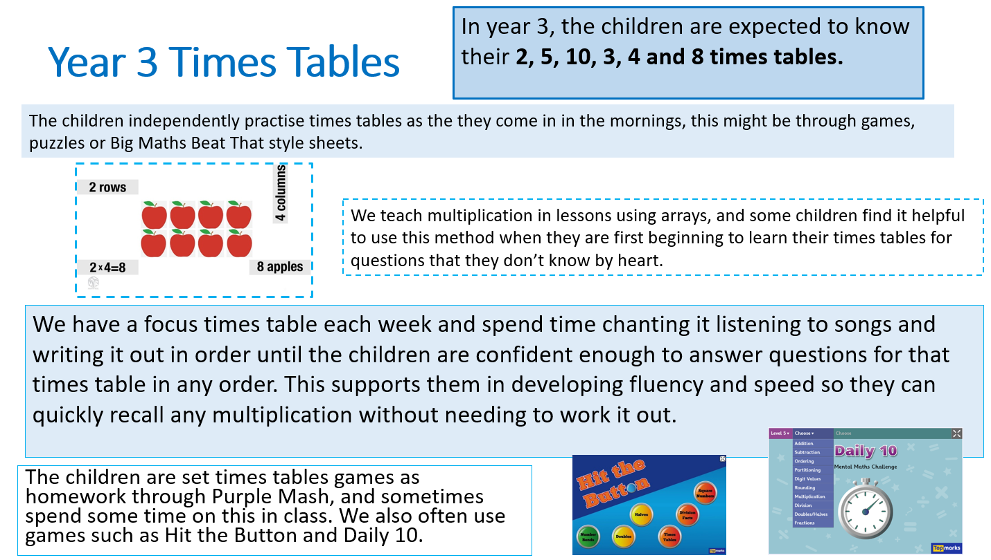

Slide 16
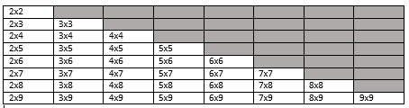
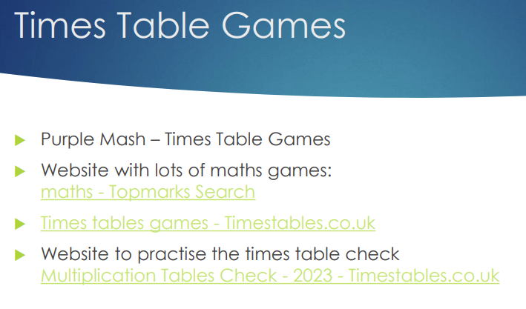
36 Core times tables
This takes out the inverse – 3x4 and 4x3
Takes out the 1, 10, 11, 12
How to help at home:
Times table games
Times table Rockstars – Year 4

Slide 17
How best to prepare your child for the check
If you want to go over times tables, make them fun.
If you have any concerns, talk to your child’s teacher.
If your child has any concerns, encourage them to talk to a trusted adult (for example, yourself, their teacher).
If you’re looking to support your child further with maths at home, there are lots of good websites with free resources, we have put many links on the school website!
Notes:
Games to try:
Climb the stairs counting in multiples
Play time tables games verbally.
Listen and sing along to times tables songs.
Take it in turns to say times tables in funny voices.
Play maths games online.

