Slide 1
Meet the Teacher
Year 3
Mrs Taylor, Mr Neville and Mr Fenton

Slide 2
Welcome Back
Year 3 Team
3FT – Mrs Taylor and Mr Fenton
- Mrs Lockhart
3N – Mr Neville
- Mrs Hall

Slide 3
School Timings and Timetable for the Week
School starts at 8:45am each day
There will be Early Bird Groups will be from 8:30am – 9:00am. With the exception of running club that starts at 8am.
PE for Year 3 will be on a Wednesday and a Friday. Children should keep their PE kit in school each week incase these days change.

Slide 4
Homework
Daily reading should be happening at home – signed reading record.
Maths and English homework will be sent home weekly. It will go out on a Friday and should be given back in by the following Friday.
Spellings will be sent out each week – sent out Friday for a test the following Friday. Each half term your
Times tables will take place in class weekly.
Each half term your child will be given a piece of creative homework to complete. This will be set just before the holidays and the children will have the holidays and 2 weeks after to complete.

Slide 5
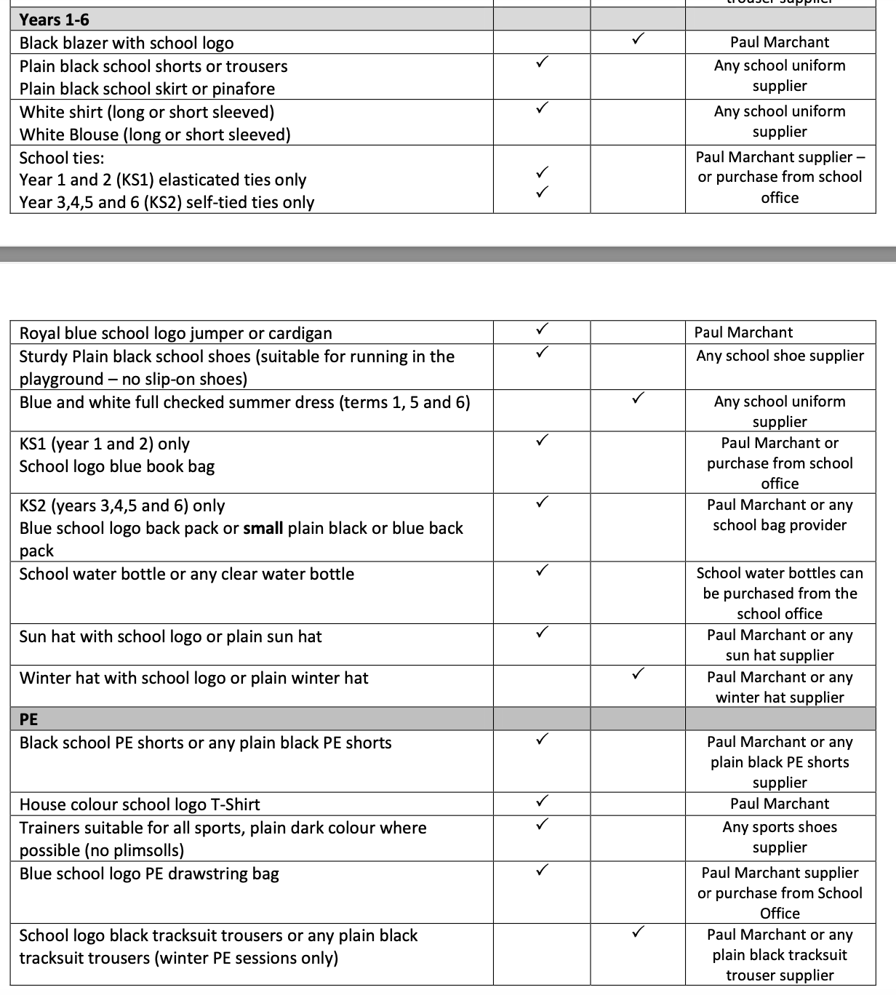
Uniform
There is a new uniform policy:

Slide 6
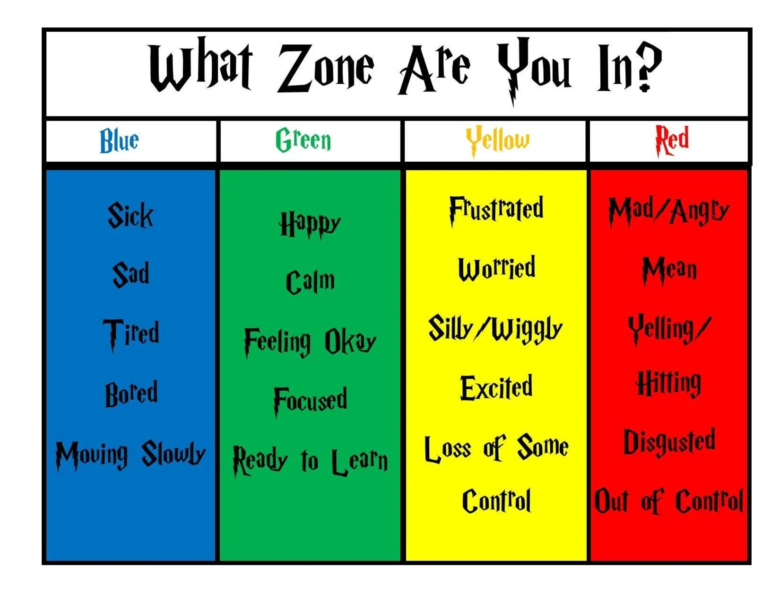
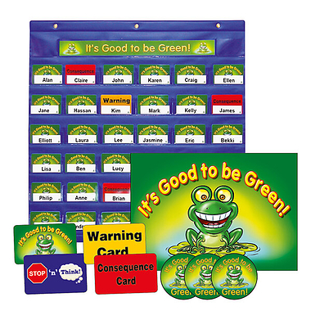
Learning Expectations and Behaviour
Good to be Green
Zones of Regulation

Slide 7
What to bring to school
If your child would like a snack, please provide a healthy break time snack.
Children will be provided with a pencil case however they may bring in a small pencil case with colouring pencils if they wish.
One small toy (not precious and must fit in coat pocket) for play time if they wish.

Slide 8
Methods of communications
All communications should come through the office
Homework will be sent and put on our class page.
If you need to send a message to the class teacher, please email the office who will pass on the message.
The website will be kept up to date so do keep an eye on it for any announcements or changes.

Slide 9
Term 1 Trip
We have got an exciting trip planned for the end of this term.
The trip is subject to approval as we are still finalising the cost.

Slide 10
Thank you for listening. Questions:
How do parents support children with Latin?
In the first instance, allow class teachers to guide any support needed through homework tasks, but if you would like to support more, parents can purchase a copy of the book (https://www.wob.com/en-gb/books/barbara-bell/minimus-pupil-s-book/9780521659604?gclid=Cj0KCQjwguGYBhDRARIsAHgRm4-mXL2GZBJgegol-EnplfXAdkpI-xgtHpeoZiVUGRLP9apdox8rHIIaAqp9EALw_wcB#GOR001454926)

Slide 11
Thank you for listening. Questions:
Will the children be going swimming?
This will not be until Term 6 and we will be sending out letters ahead of time.

Slide 12
Thank you for listening. Questions:
Will we find out the SATS results?
If you have not received these at the end of last year, please contact the office or class teacher to find out your child’s KS1 SATs results if you would like to know them.
We will be carrying out our own Year 3 baseline assessments in the next couple of weeks to base our planning on to ensure we have up to date information on how children are accessing the curriculum after the Summer.

Slide 13
Thank you for listening. Questions:
How will Early Bird Clubs work?
Children will be invited to these as teachers deem necessary. These will take place in new intervention areas around the school so learning will not be interrupted when other children arrive for school.

Slide 14
Thank you for listening. Questions:
What is going to happen with reading books?
Children will be heard read by class teachers this week and come home with levelled reading books to read at home.
If your child meets the criteria to be a free reader, we will ensure your child is able to choose their own reading book to bring home.

